Slide 1

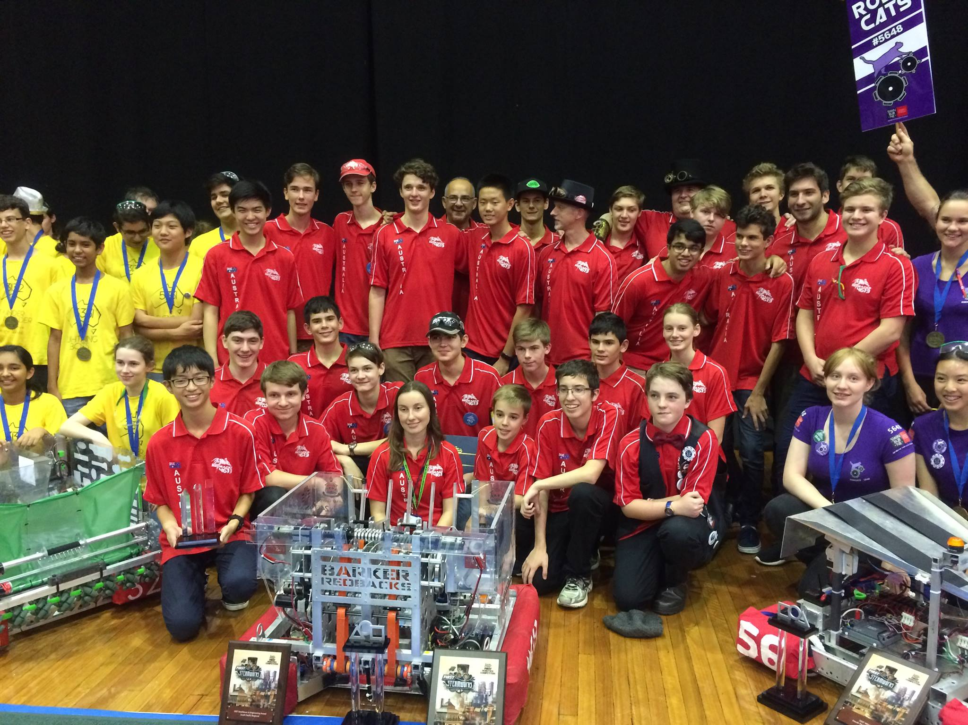
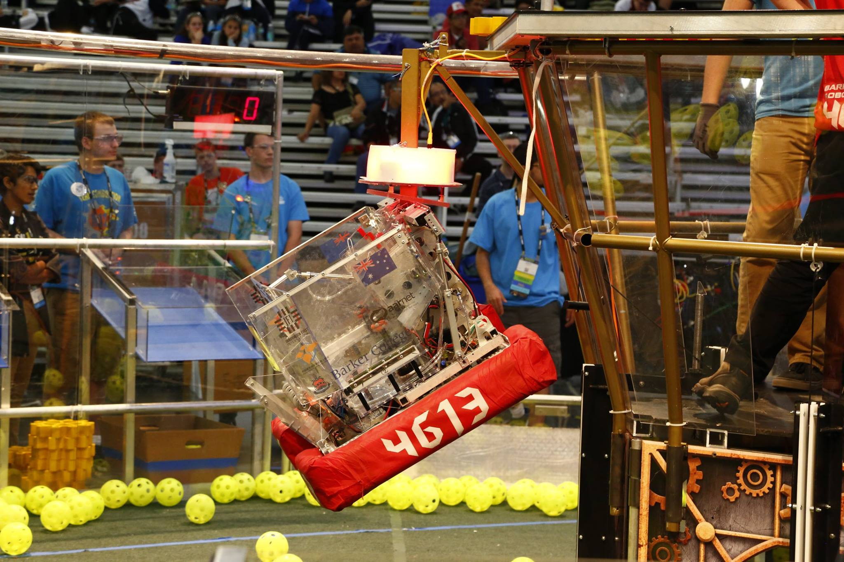
Introduction to (Java) Programming – 2.6 - Operations
Tom Schwarz

Slide 2
Lesson 7: Operations
Computers are quite good at doing maths. And, you can very easily have them do maths for you.
In code you can integrate maths and it will be executed following BODMAS laws.
For example you can write:
System.out.println(2*(5+(3/2));
Which should produce 13

Slide 3
Lesson 7: Operations
System.out.println(2*(5+(3/2)));
Which should produce 13
However, do you remember how integers have no decimals?
As these numbers have no decimals, they are treated as integers
As we are dividing an integer by an integer, an integer is produced
However 3/2 = 1.5 which is a double ! Java truncates this to an integer, to produce 1
Thus the above example gives 12
This can be easily fixed by changing an affected number to a double, as a double/integer (or other way around) gives a double – Java wouldn’t want to lose information and so always choose double
System.out.println(2*(5+(3/2.0)));

Slide 4
Lesson 7: Operations
You can also use variables:
int bestestNumber = 8; int worstestNumber = 3; System.out.println((bestestNumber%worstestNumber)*3);
Remember that the “%” operator is like “/” (divide) but producers the remainder
E.g. 362 % 360 = 2

